Slide 1
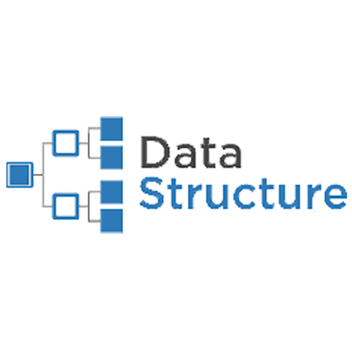

Data Structures in Python
A concise reference guide to four fundamental Python data structures: List Tuples, Sets, and Dictionaries.

Slide 2
Data Structures in Python
In Python, a data structure is a format for organizing and storing data in a way that enables efficient access and manipulation. The language has four main built-in data structures—lists, tuples, dictionaries, and sets—as well as other user-defined and module-based structures
Think of it this way: Imagine a library with books as data elements and the library shelves as the data structures. It is easier to browse the vast number of books when they are organized/ categorised into different sections (fiction, non-fiction, etc.). Similarly, data structures provide a systematic way to store and access data based on its type and intended use.

Slide 3
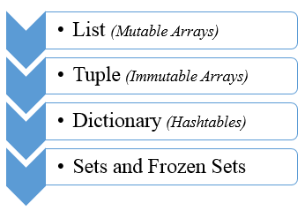
Python provides four fundamental built-in data structures: list, tuple, dictionary, and set
Built-in data structures are data structures supported by default in a programming language. They come with pre-defined syntax and behavior, and can be used without having to import additional libraries or modules. In Python, this includes data structures like lists, tuples, sets and dictionaries.

Slide 4
Data Structure #1: Lists in Python
  Lists in Python are the most versatile data structure.
  They are used to store heterogeneous data items, from integers to strings or even another list!
  They are also mutable, meaning their elements can be changed even after creating the list.
Creating Lists
  Lists are created by enclosing elements within [square] brackets, and each item is separated by a comma:
# Creating a list
alist = ['science', 'math', 'english']
print(type(alist))
print(alist)

Slide 5
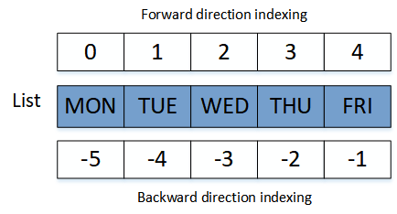
Accessing List Elements
To access elements of a list, we use Indexing. Each element in a list has an index related to it depending on its position in the list. The first element of the list has the index 0, the next element has index 1, and so on. The last element of the list has an index of one less than the length of the list.
#Indexing
alist[0]
alist[-1]
alist[2]

Slide 6
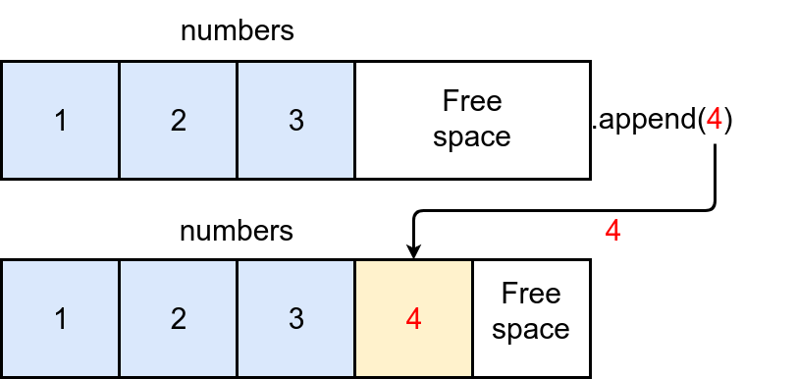
Appending Values in Lists
  We can add new elements to an existing list using the append() or insert() methods:
  append() – Adds an element to the end of the list
  insert() – Adds an element to a specific position in the list that needs to be specified along with the value

Slide 7
Removing Elements from Lists
Removing elements from a list is as easy as adding them and can be done using the remove() or pop() methods:
  remove() – Removes the first occurrence from the list that matches the given value
  pop() – This is used when we want to remove an element at a specified index from the list. However, if we don’t provide an index value, the last element will be removed from the list

Slide 8
Sorting Lists
Most of the time, you will use a list to sort elements. So, it is essential to know about the sort() method. It lets you sort list elements in place in either ascending or descending order:
Concatenating Lists
We can even concatenate two or more lists using the + symbol. This will return a new list containing elements from both the lists:

Slide 9



Tuples: Ordered and Unchangeable
Definition and Conceptual Understanding
A tuple is an ordered, immutable collection of items. Unlike lists, a tuple cannot be changed (mutated) after its creation.
  They are highly efficient, often stored as a single contiguous memory block.
  Tuples are used primarily to ensure data integrity where modifications must be prevented.
Syntax Example
my_tuple = (10, "Python", 3.14)
Ordered
Immutable
Allows Duplicates
Preserves the insertion order.
Elements cannot be added, deleted, or modified.
Multiple identical items are permitted.

Slide 10
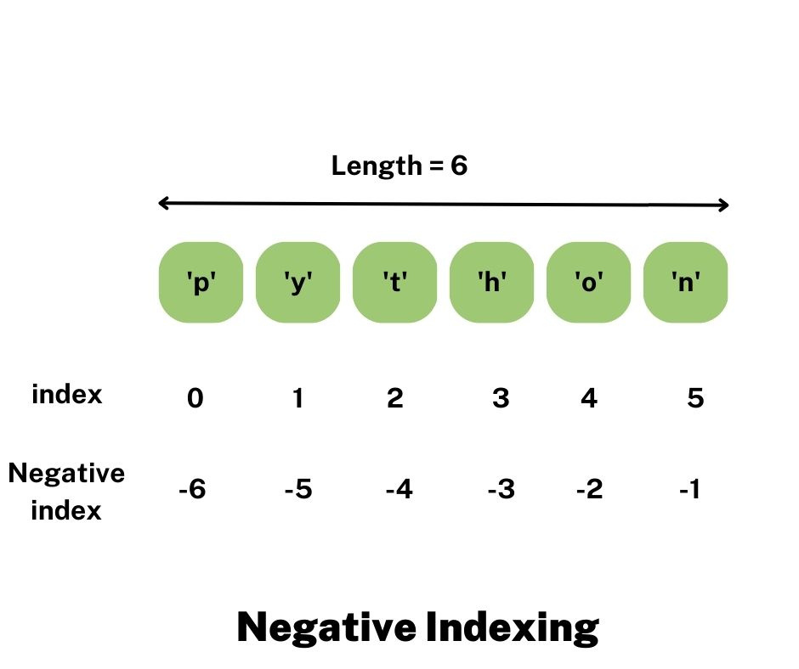
Tuple Internal Working and Core Use Cases
Memory Efficiency
Python stores tuples as arrays of object references in contiguous memory. This compact structure makes them generally faster than lists for iteration and access.
Function Returns
Ideal for functions that need to return multiple values, often implicitly packing them into a single tuple object.
Fixed Data Storage
Excellent for data that should not change, such as geographic coordinates (e.g., (27.7, 85.3)) or constant configuration settings.
Dictionary Keys
Since tuples are immutable, they are hashable and can be used as keys in Python dictionaries, unlike mutable lists.
Practical Example: Storing Records
coordinates = (27.7, 85.3)person = ("Anish", 21, "Nepal", "Software Developer")

Slide 11



Tuple Operations: Access, Combination, and Unpacking
Accessing Elements
Combining Tuples
Tuples support standard sequence operations like indexing and slicing to retrieve elements.
You can use the + operator for concatenation and the * operator for repetition.
t1 = (1, 2); t2 = (3, 4)
print(t1 + t2)
# Output: (1, 2, 3, 4)
print(t1 * 2)
# Output: (1, 2, 1, 2)
person = ("Anish", 23, "Nepal")print(person[0])
# Output: Anish
print(person[1:])
# Output: (23, 'Nepal')
Tuple Packing and Unpacking
This allows for easy assignment of values from a tuple to multiple variables simultaneously, a highly useful Python feature.
Packing
Unpacking
Result
my_tuple = 1, 2, 3
a, b, c = my_tuple
a = 1, b = 2, c = 3

Slide 12
Sets: Unordered, Unique Elements
A set is an unordered collection of unique elements, modeled after mathematical set theory. They excel at managing unique members and performing membership tests.
Unordered and Unindexed
No Duplicates
Mutable (Set)
Elements have no defined order and cannot be accessed by index.
Automatically ensures every element is unique. Duplicates are silently discarded.
The set collection itself can be modified (elements added/removed), but the elements stored must be immutable.
Internal Mechanism: Hashing
Sets use a hash table internally to store elements. This structure allows for highly optimized, average O(1) time complexity for membership testing (in keyword).
my_set = {1, "apple", 3.14}

Slide 13
Set Use Cases and Duplicate Removal
Key Applications of Sets
  Deduplication: Removing duplicate entries from other iterable data structures like lists.
  Fast Membership Testing: Quickly checking if an element exists within a large collection.
  Mathematical Set Operations: Performing union, intersection, and difference calculations.
Example: Removing Duplicates
nums = [1, 2, 2, 3, 3, 4, 1]unique_nums = set(nums)print(unique_nums) # Output: {1, 2, 3, 4}
Basic Operations
s = {1, 2, 3}s.add(4) # Adds 4 to the sets.remove(2) # Removes 2 (raises error if not present)s.discard(5) # Removes 5 if present (no error)

Slide 14



Advanced Set Operations (Set Algebra)
Python sets provide built-in methods and operators for standard mathematical set operations, useful for data analysis and filtering.
Union (|)
Intersection (&)
Difference (-)
Returns a new set with all elements from both sets. A | B
Returns a new set containing only elements common to both sets. A & B
Returns a new set with elements from the first set that are not in the second set. A - B
Relational Checks
isdisjoint()
issubset()
issuperset()
Checks if two sets have no elements in common.
Checks if all elements of one set are in another.
Checks if one set contains all elements of another.
A = {1, 2, 3}; B = {3, 4, 5}print(A | B) # {1, 2, 3, 4, 5}print(A & B) # {3}

Slide 15
Dictionaries: Key-Value Mapping
Definition and Core Concepts
A dictionary is an unordered (since Python 3.7, insertion-ordered) collection of key-value pairs. They map unique, hashable keys to arbitrary values.
  Conceptualized as a real-world dictionary: you look up a definition (value) using a word (key).
  Internally uses a hash map for extremely fast lookups.
  Keys must be unique and immutable (e.g., strings, numbers, tuples).
Keys
Values
Mutable
Unique, immutable identifiers.
Can be any data type, mutable or immutable.
Dictionaries are dynamic; they can be changed after creation.
Syntax
my_dict = {"name": "Anish", "age": 23, "city": "Kathmandu"}

Slide 16
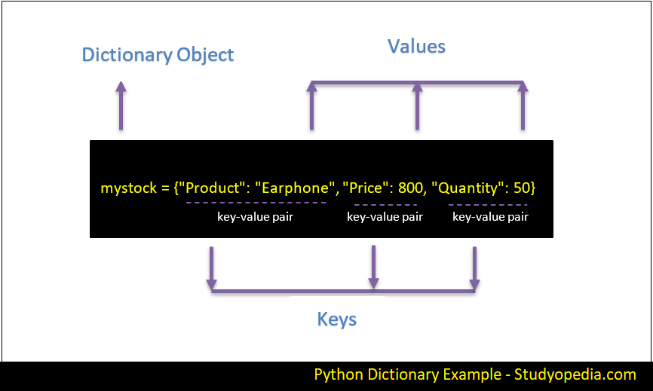
Dictionary Internal Working and High-Speed Access
Internal Hash Table
The key-value pairs are stored within a hash table structure. When you look up a value, the key is hashed to compute an address (index) in the table.
This hashing process results in:
  Average Time Complexity for Access, Insertion, and Deletion: O(1)
  This makes dictionaries one of the most efficient data structures for retrieval.
Use Cases
Data Configuration
Frequency Counting
Mapping Objects
Storing settings, user profiles, or system configurations (JSON-like data).
Efficiently tracking the occurrences of items (e.g., word counts in text).
Creating associations between related data points, like IDs to names.

Slide 17
Dictionary Operations: Manipulation and Views
Adding & Updating
New keys are added via simple assignment. Existing keys are updated the same way.
student["country"] = "Nepal"
Removing Elements
Use pop() (returns value) or del keyword for removal.
student.pop("age")del student["dept"]
Viewing Contents
Methods like keys(), values(), and items() return dynamic views of the dictionary content.
print(student.keys())
Advanced Technique: Dictionary Comprehension
A concise way to create dictionaries from expressions or existing data.
# Maps numbers 0-4 to their squaressquares = {x: x**2 for x in range(5)} # Output: {0: 0, 1: 1, 2: 4, 3: 9, 4: 16}

Slide 18
Let’s Practice
Create a list and set with five fruits. Display the first and last fruit.
Create a dictionary with 3 students and their marks. Print all names and their marks.
From a dictionary of student names and marks, find and print the student with the highest
mark.
WAP to ask the user to enter names of their 3 favorite movies & store them in a list.
WAP to check if a list contains a palindrome of elements. (Hint: use copy( ) method)
WAP to count the number of students with the “A” grade in the following tuple.
[“C”, “D”, “A”, “A”, “B”, “B”, “A”]
Store the above values in a list & sort them from “A” to “D”

Slide 19
Let’s Practice
Store following word meanings in a python dictionary :
You are given a list of subjects for students. Assume one classroom is required for 1
subject. How many classrooms are needed by all students.
”python”, “java”, “C++”, “python”, “javascript, “java”, “python”, “java, “C++”, “C”
Store following word meanings in a python dictionary :
table : “a piece of furniture”, “list of facts & figures”
cat : “a small animal”
WAP to enter marks of 3 subjects from the user and store them in a dictionary. Start with
an empty dictionary & add one by one. Use subject name as key & marks as value.
Figure out a way to store 9 & 9.0 as separate values in the set.
(You can take help of built-in data types)

